Slide 1

R.V.R & J.C College of Engineering Chowdavaram,Guntur,A.P.
Team number-22
Dif-Fusion: Toward High Color Fidelity in Infrared and Visible
Image Fusion With Diffusion Models
Guide Name : Sri. N.Chandra Sekhar
TEAM MEMBERS:-
Y21CS182 V AKSHAY SAI
Y21CS184 V SAI PHANINDRA
Y21CS170 T VENKATA NARAYANA

Slide 2
AGENDA:-
Team number-22
ARCHITECTURE
METHODOLOGY
IN DETAIL ABOUT METHODOLOGY
ALGORITHUM USED
DETAILS OF DATASETS
EXPERIMENTAL SETTINGS
ANALYSIS OF RESULTS
ADVANTAGES
CONCLUSION
REFERENCES

Slide 3
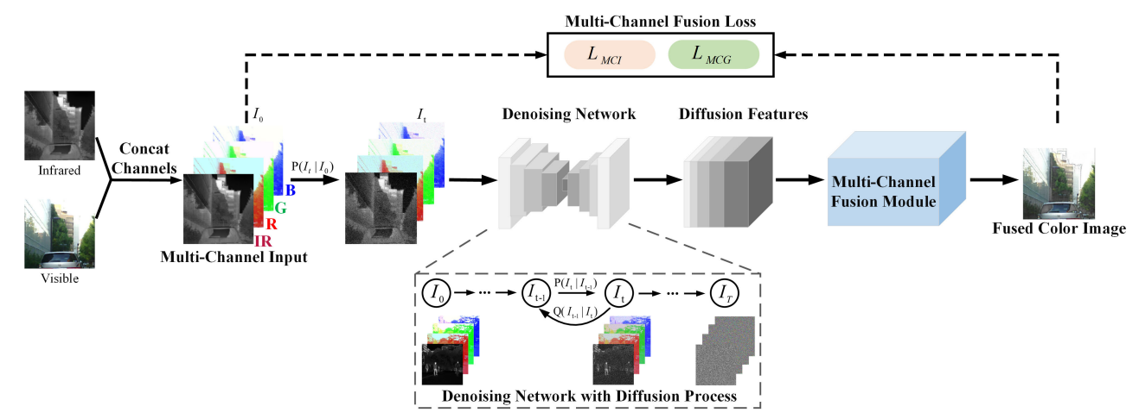
Team number-22
ARCHITECTURE:-
Fig. 2. The overall framework of Dif-Fusion. I0 and It denote the multi-channel input and the multi-channel data in the forward diffusion process with t timesteps. P(·|·) and Q(·|·) stand for the forward diffusion possess and reverse diffusion process. LMCI and LMCG represent multi-channel intensity loss and multi-channel gradient loss

Slide 4
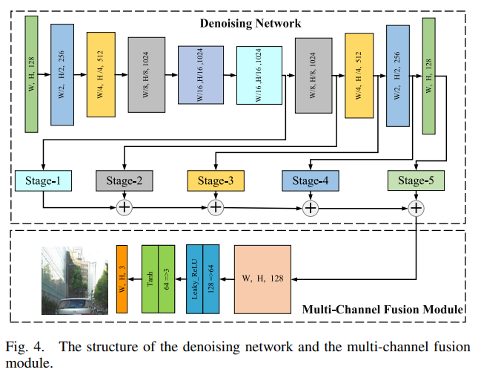

Slide 5
METHODOLOGY-MODULE PROPOSED:-
Team number-22
DIF-FUSION:-
The existing infrared and visible image fusion methods can be categorized into three major categories:
CNN-based
Generative model-based
AE(Auto Encoder)-based
The proposed Dif-Fusion falls under the second group.

Slide 6
DETAILS OF PROPOSED TECHNIQUES
Team number-22
First, we directly feed multi-channel data composed of 1-channel IR image and 3-channel visible image, and construct multi-channel distribution in the latent space through diffusion process.
The diffusion process is a Markov process, which is divided into a forward process and a reverse process .
In the forward process, Gaussian noise is incrementally added to the multi-channel input data,
In the reverse process, the noise added in the forward process is eliminated with multiple timesteps

Slide 7
ALGORITHUM:- 1. Import necessary libraries and modules 2. Define and parse command line arguments 3. Setup logging for training and testing 4. Initialize Tensorboard logger 5. Load dataset for testing 6. Initialize and load diffusion model 7. Create Fusion model 8. Perform model evaluation (testing) 9. Create directory for test results 10. Iterate over test data loader a. Feed data to diffusion model b. Extract features at different time steps c. Feed features to Fusion model d. Perform testing on Fusion model e. Get predicted visual outputs f. Convert tensor to image g. Save image to test result directory 11. Log end of testing

Slide 8
Team number-22
DETAILS OF DATASETS:-
We utilize the color and infrared image pairs from the
MSRS (Dataset contain 1083 images, 361 pairs for testing images,remaining are training images)
RoadSence (Dataset contain 408 images, 286 training set,40 test set,82 validation set)
M3FD dataset (Dataset contain 8400 images(for fusion, detection and fused-based detection) and 600 images(independent scene for fusion)

Slide 9
EXPERIMENTAL SETTINGS:
Evaluation Metrics:-
Six statistical metrics are used in the quantitative evaluation five of which are:
MUTUAL INFORMATION (MI) : MI primarily assesses how well the information from the initial image pairs has been aggregated in the fused image.
VISUAL INFORMATION FIDELITY (VIF) : VIF evaluates the fidelity of the information present in the fused image.
SPATIAL FREQUENCY (SF) : The spatial frequency-related information in the combined data is measured by SF
Qabf : The edge information from the source images is quantified using Qabf.
STANDARD DEVIATION (SD): SD primarily evaluates the contrast of composite images
Specifically, we introduce the Delta E , a color difference calculation index built in CIELAB space to quantify the color distortion between the fused image and the original visible image.

Slide 10
Team number-22
We also compare our method with six state-of-the-art algorithms:
SDNet [29]
U2Fusion [1]
FusionGAN [9]
SDDGAN [31]
GANMcC [22]
TarDAL [30]
fusion approaches based on CNN architectures
based on generative models
The proposed model is trained on the MSRS dataset, which includes 1083 training pairs of visible and infrared images. There are 361 pairs of test images in the MSRS dataset

Slide 11
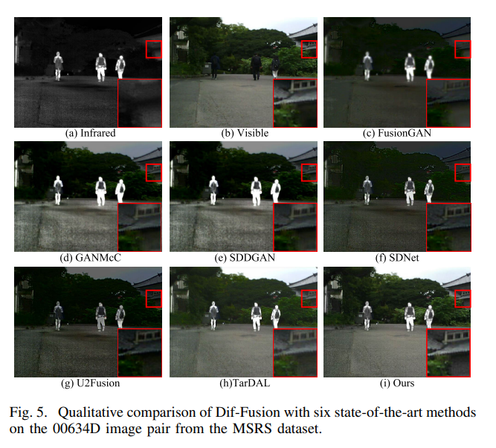
ANALYSIS OF RESULTS:-
QUALITATIVE ANALYSIS:-

Slide 12
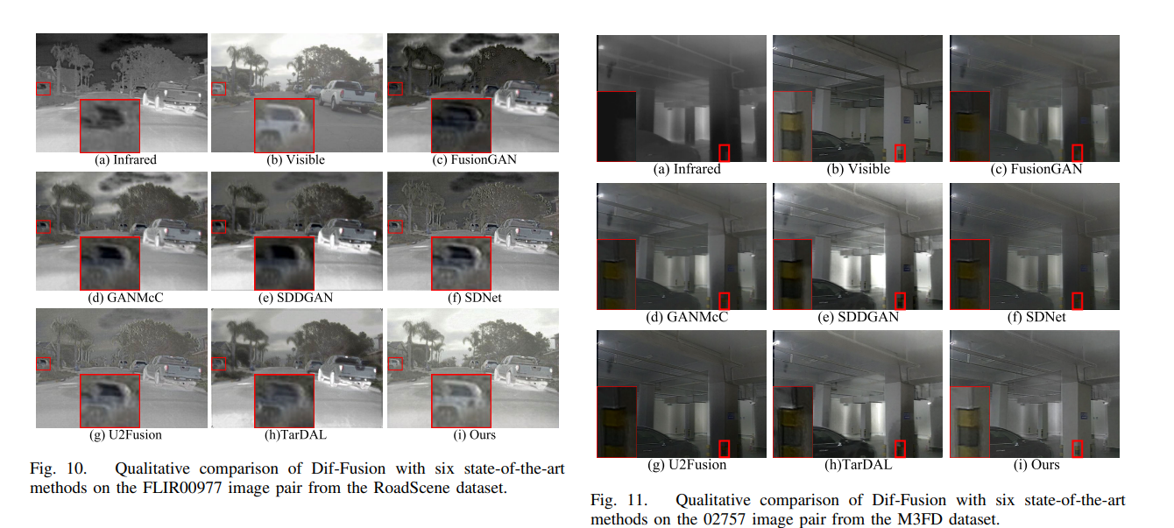

Slide 13
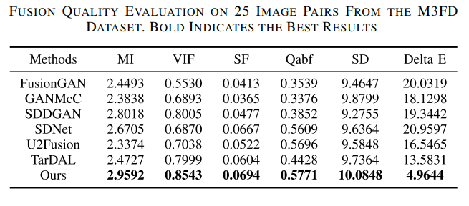
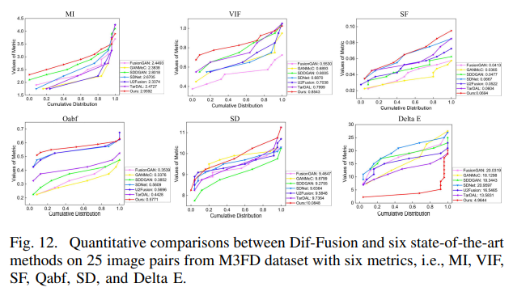
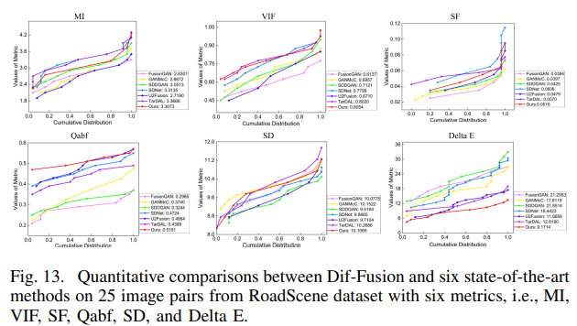
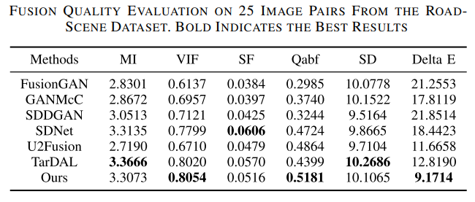
QUANTITATIVE ANALYSIS:-

Slide 14
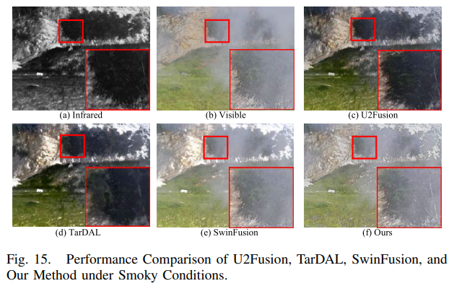
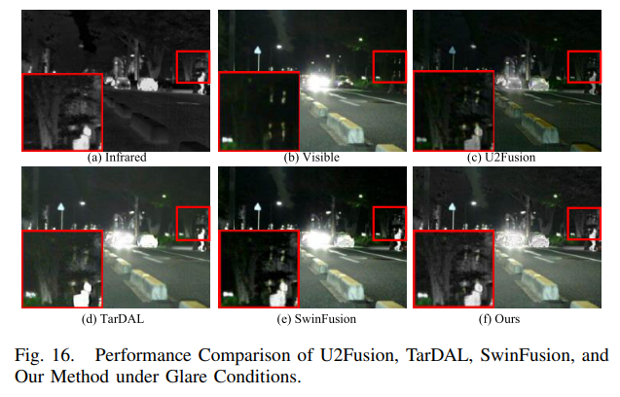
SwinFusion [50], a representative algorithm based on Transformers, are chosen to conduct additional analysis on challenging scenes (such as smoke and glare).

Slide 15
ADVANTAGES:-
Diffusion models have become a powerful family of deep generation models with record breaking performance in many areas
including image generation
image inpainting
image super-resolution
image-to-image translation
By compared with other models it generates high colured images

Slide 16
Team number-22
CONCLUSION:
The newly proposed Dif-Fusion is based on Diffusion, which falls within the category of generative model-based image fusion frameworks, achieving state-of-the-art performance. However, there are still several directions that need to be further explored in the future. First, compared to other generative model-based or CNNbased fusion models in image fusion area, the entire process of Dif-Fusion is computationally expensive, with over 99% of the time spent on the Diffusion process. In recent years, there has been increasing attention towards accelerating the diffusion process, indicating potential for significant improvements in the efficiency of Diffusion-based algorithms Therefore, there is a need for more exploration into the relationship between Diffusion-based fusion models and the diversity of multimodal data

Slide 17
REFERENCES:-
H. Xu, J. Ma, J. Jiang, X. Guo, and H. Ling, “U2Fusion: A unified unsupervised image fusion network,” IEEE Trans. Pattern Anal. Mach. Intell., vol. 44, no. 1, pp. 502–518, Jan. 2022. [1]
J. Ma, L. Tang, M. Xu, H. Zhang, and G. Xiao, “STDFusionNet: An infrared and visible image fusion network based on salient target detection,” IEEE Trans. Instrum. Meas., vol. 70, pp. 1–13, 2021.[4]
J. Liu et al., “Target-aware dual adversarial learning and a multiscenario multi-modality benchmark to fuse infrared and visible for object detection,” in Proc. IEEE/CVF Conf. Comput. Vis. Pattern Recognit. (CVPR), Jun. 2022, pp. 5792–5801.

Slide 18

Team number-22

